Slide 1



IDEATION TOOLS
HOW TO USE?
BOOTCAMP ONE | DAY THREE
HCD EXERCISE | IDEATION
GENERATE & ORGANISE IDEAS
Brainstorming Principles
Tool 1: First Idea + Crazy Idea
1
Encourage wild ideas and don’t judge if they will work immediately.
First Idea
What are the first ideas that to your mind?
Crazy Idea
What are the crazy ideas that come to your mind?
Objective of Exercise
To generate as many creative ideas as possible. To organise ideas by theme/focus/type.
Tool
First Idea + Crazy Idea, What If?, SCAMPER, Affinity Map
About ‘First Idea + Crazy Idea’
To get the ball rolling, this is used to get the top of mind ideas out of the way.
About ‘What If?’
A tool that lists some fairly straight forward macro options there are for solutions.
About ‘SCAMPER’
A tool that is especially useful to think of options for solutions at a micro level.
About ‘Affinity Map’
Like in insighting, used to group ideas by the patterns.
2
Come up with as many ideas as possible - go for quantity!
Record everything! Don’t miss out on important thoughts and discussions.
1
3
First Ideas
Note down: The first, top of mind ideas that everyone participating has.
4
Build on the ideas of others and stay focused on the topic while discussing.
Encourage one conversation at a time so each idea gets full attention.
2
5
Crazy Ideas
Note down: The most crazy ideas that everyone participating has.
6
Iterate! Most times solutions are not obvious.
FINANCIAL INNOVATION LAB | BOOTCAMP ONE

Slide 2
IDEATION TOOLS
HOW TO USE?
HCD EXERCISE | IDEATION
GENERATE & ORGANISE IDEAS
Tool 2: What If?
Tool 3: SCAMPER
What if the solution…?
Is a physical object or a thing
A service or process
A person or set of people
A digital interaction
A piece of communication
Does the solution lie in...?
Substituting, replacing or changing some part or whole of something?
Combining two or more parts of something into something new?
Adapting or being inspired from something else that has worked?
Modifying, magnifying or minimising some part of whole of something?
Putting something to a different use than initially thought?
Eliminating some part or entirety of something?
Rearranging the sequence or order of parts of something?
1
2
1
2
Design Challenge
Review: Review the design challenge, insights, journeys, and persona.
What If?
Note down: Ideas under each of the types (physical object, service, person, interaction, communication)
Insights, Journey, Persona
Review: Review the insights, the journey map, and the persona.
SCAMPER
Note down: Ideas that emerge by asking the seven different questions under SCAMPER (Substitute, Combine, Adapt, Modify, Put to Another Use, Eliminate, Rearrange).
Tool 4: Affinity Map
1
2
Ideas
Group: Ideas that seem similar to each other or are of a similar theme or are focused on . Keep distinct ideas separate.
Choose
Pick: Ideas that you want to decide between.
FINANCIAL INNOVATION LAB | BOOTCAMP ONE

Slide 3
BOOTCAMP ONE | DAY THREE
HCD EXERCISE | IDEATION
GENERATE & ORGANISE IDEAS
Notes
Session Flow
Sharing the Objective | 2 Min
Facilitators to share the objective of the session/exercise.
Walkthrough - Example | 10 Min
Facilitators to walk through 1-2 examples of the tool in use.
Walkthrough - ‘How To?’ | 10 Min
Facilitators to walk through the ‘How to?’ of the tool as per instructions on the toolsheet.
Clarifications | 8 Min
Facilitators to clarify doubts from participants.
Exercise | 45 Min
Participants to use tool with guidance from the facilitation team. Since there are multiple tools, a recommended flow could be -
First Idea + Crazy Idea - 5 Min
What If? - 10 Min
SCAMPER - 15 Min
Affinity Map - 15 Min
Points to Consider
The numbering provided in the How To? is a recommended path. Startups may still choose to fill the template as per their convenience.
Brainstorming should be first done as individuals - that is why ‘First Idea + Crazy Idea’ works well to begin with. Trying to come up with ideas together can be cumbersome and time wasting.
It is important that one moves from one ideation tool to another in quick succession. Individuals can write ideas down on Post-It notes at each step and keep moving on.
Sharing and consensus should be left to the last step.
There are many different tools out there for ideation and brainstorming. This is a collection of a handful of tools and in no way authoritative.
Do not get attached to one’s ideas. It is a bad idea to do so and hampers the progress the team can make.
Tools
First Idea + Crazy Idea, What If?, SCAMPER, Affinity Map
Material
Templates, Chart Paper, Post-Its, Pens/ Sketch Pens
Time
75 Minutes
FINANCIAL INNOVATION LAB | BOOTCAMP ONE

Slide 4
IDEATION TOOLS: First Idea + Crazy Idea, What If?
First Idea + Crazy Idea
What If the solution...?
First Ideas
What are the first ideas that come to the minds of individuals on the team?
Is a physical object or a thing
A service or process
A person or set of people
Crazy Ideas
What are the crazy ideas that come to the minds of individuals on the team?
A digital interaction
A piece of communication
FINANCIAL INNOVATION LAB | BOOTCAMP ONE

Slide 5
IDEATION TOOLS: SCAMPER, Affinity Map
SCAMPER | Does the solution lie in...?
Substituting, replacing or changing some part or whole of something?
Modifying, magnifying or minimising some part of whole of something?
Rearranging the sequence or order of parts of something?
Combining two or more parts of something into something new?
Putting something to a different use than initially thought?
Affinity Maps
Adapting or being inspired from something else that has worked?
Eliminating some part or entirety of something?
Ideas
Affinities / Groups
Note: For Affinity Mapping, this is not a template but a representation of how the exercise is to be done.
FINANCIAL INNOVATION LAB | BOOTCAMP ONE

Slide 6
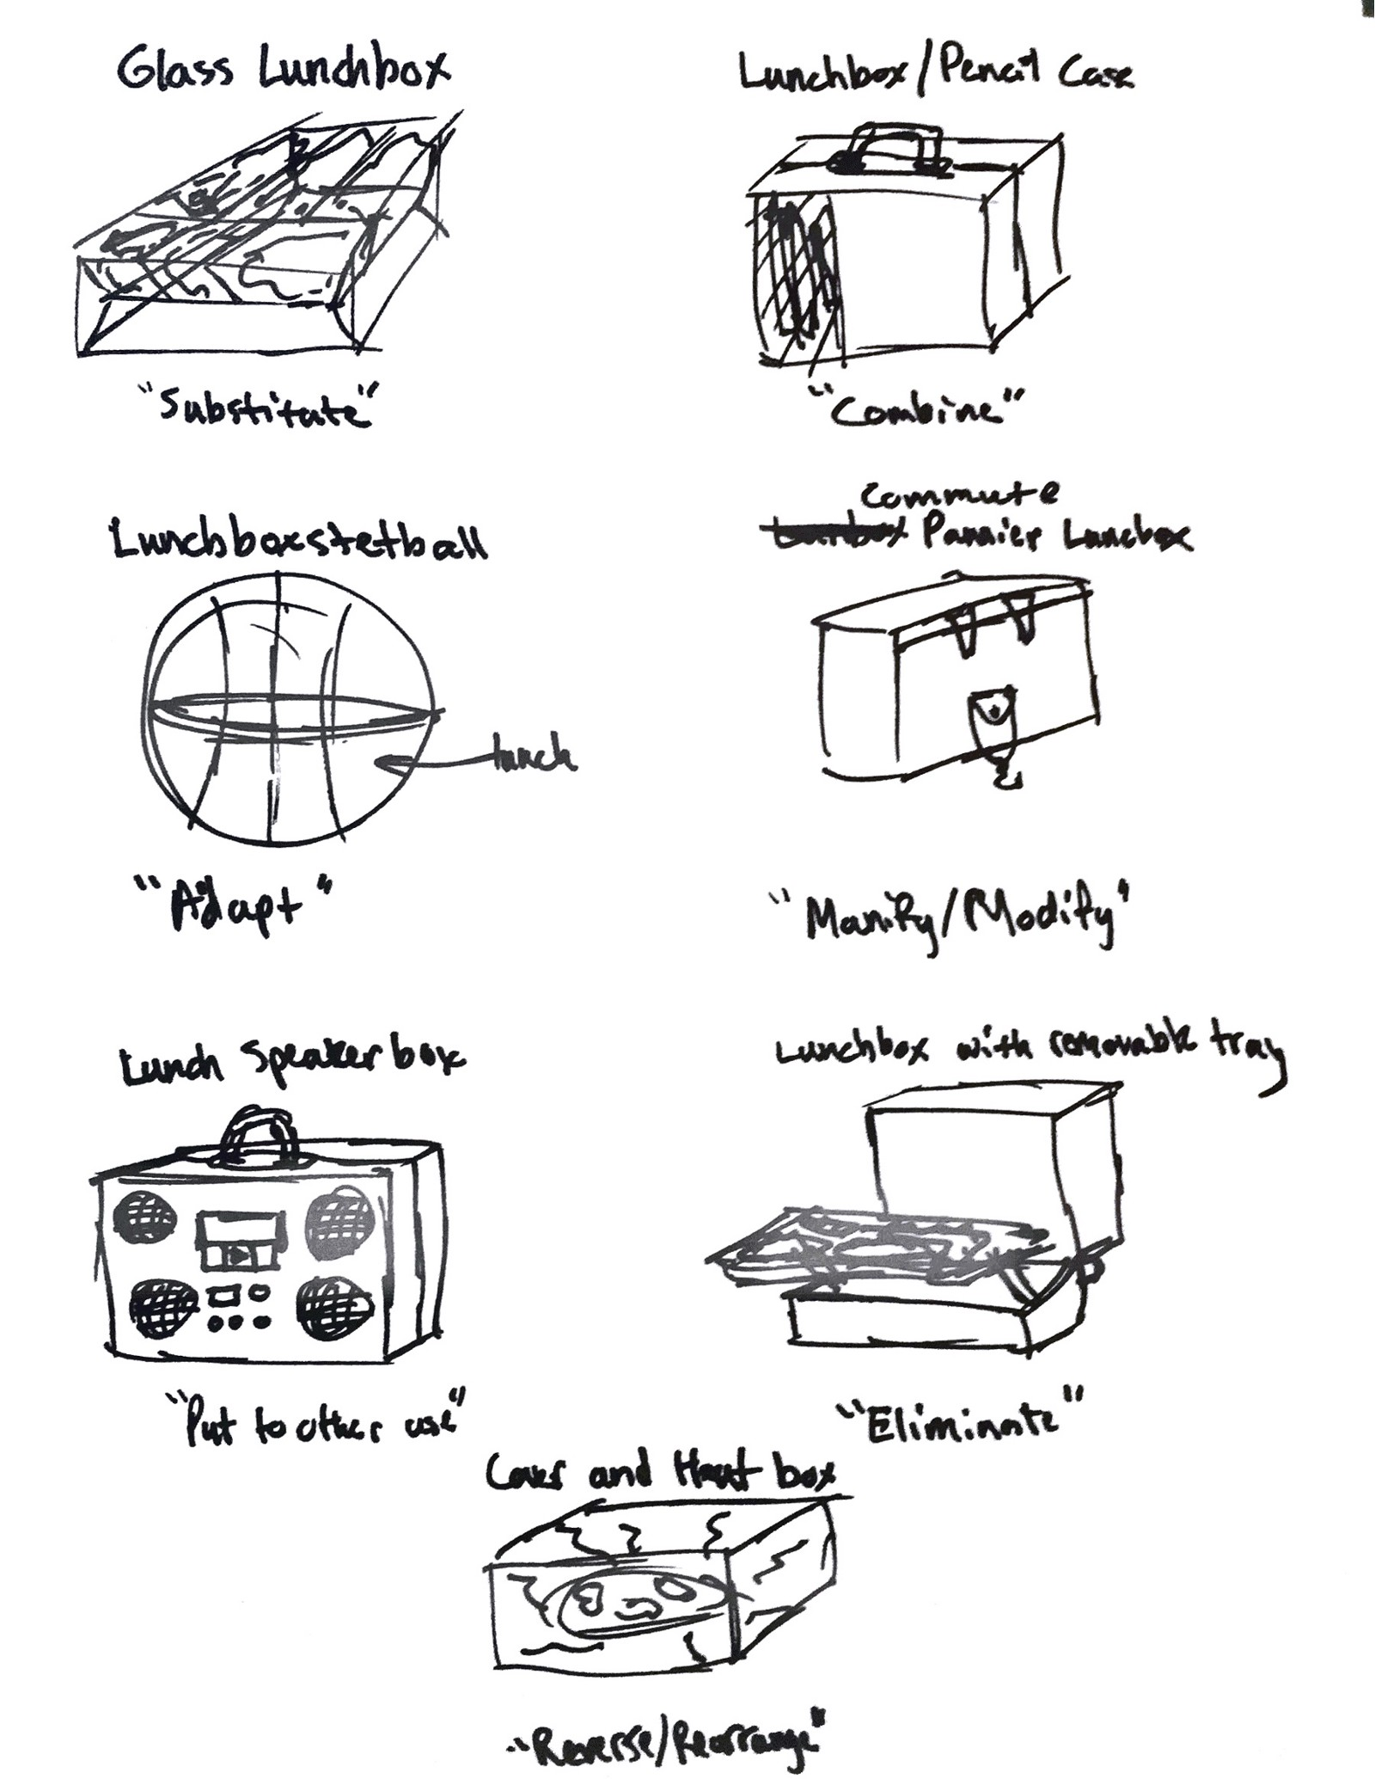
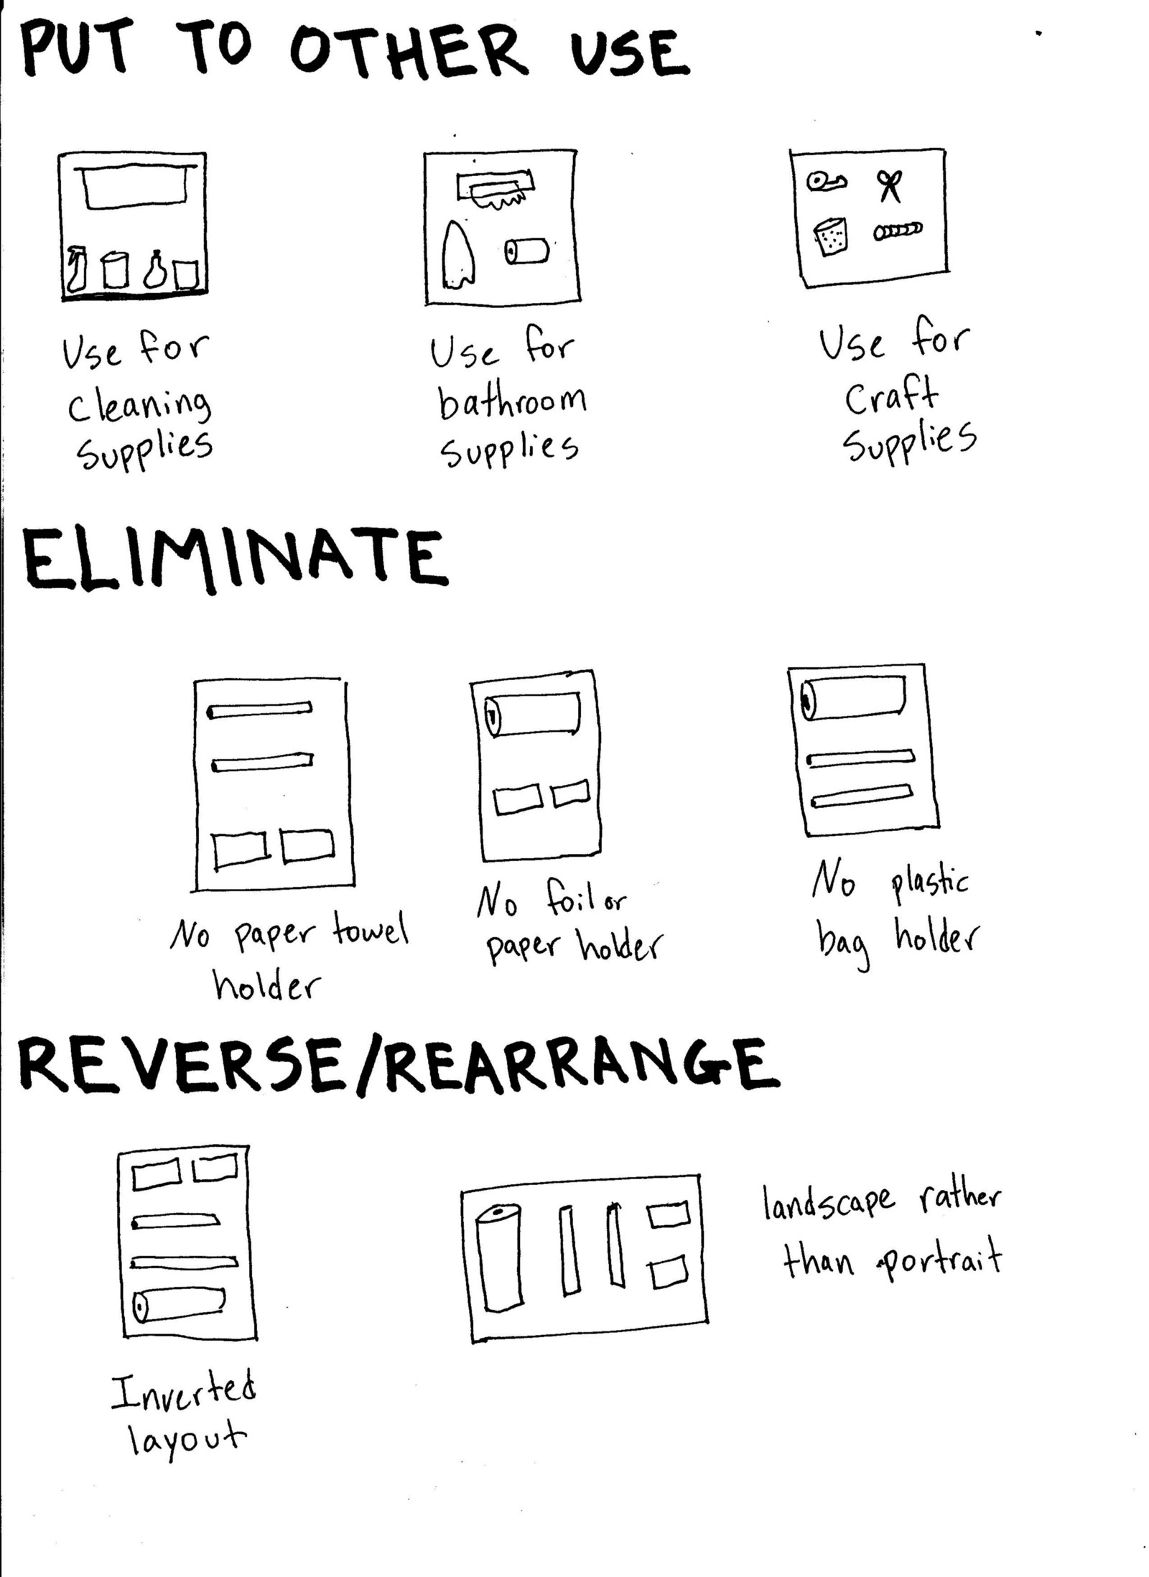
IDEATION TOOLS: SCAMPER, Affinity Map
FINANCIAL INNOVATION LAB | BOOTCAMP ONE

